Slide 1

PostgreSQL
Powerful, open source object-relational database

Slide 2

Class plan
Introduction to databases and postgresql / pgadmin
Types, databases and tables
SELECT, AND, OR and WHERE
Indexes, Relations
INSERT, UPDATE
DELETE, LIMIT, OFFSET, ORDER, GROUP
JOINS
Predefined functions SUM, AVG, DATE
Node Postgres

Slide 3
Introduction to Postgresql
PostgreSQL is a powerful, open source object-relational database system with over 30 years of active development that has earned it a strong reputation for reliability, feature robustness, and performance.
A database is an organized collection of data, generally stored and accessed electronically from a computer system. Where databases are more complex they are often developed using formal design and modeling techniques.
pgAdmin is the most popular and feature rich Open Source administration and development platform for PostgreSQL, the most advanced Open Source database in the world.

Slide 4
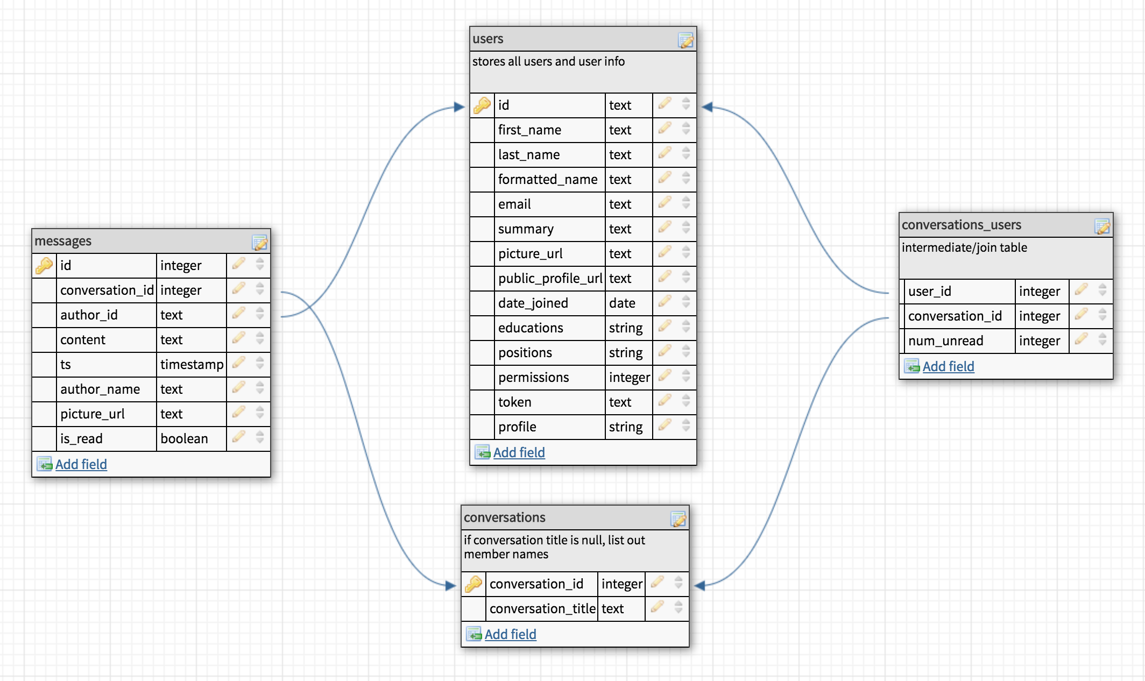
Types, Databases, Tables
Types Integer, Boolean, Date, Text, Varchar, Json, Numeric, Uuid etc.
Databases What are databases in psql CREATE DATABASE guru99;
Tables What are tables as part of database CREATE TABLE table_name (
column_name TYPE column_constraint,
table_constraint table_constraint
) INHERITS existing_table_name;

Slide 5
Examples
CREATE TABLE account(
user_id serial PRIMARY KEY,
username VARCHAR (50) UNIQUE NOT NULL,
password VARCHAR (50) NOT NULL,
email VARCHAR (355) UNIQUE NOT NULL,
created_on TIMESTAMP NOT NULL,
last_login TIMESTAMP
);
CREATE TABLE role(
role_id serial PRIMARY KEY,
role_name VARCHAR (255) UNIQUE NOT NULL
); CREATE TABLE account_role
(
user_id integer NOT NULL,
role_id integer NOT NULL,
grant_date timestamp without time zone,
PRIMARY KEY (user_id, role_id),
CONSTRAINT account_role_role_id_fkey FOREIGN KEY (role_id)
REFERENCES role (role_id) MATCH SIMPLE
ON UPDATE NO ACTION ON DELETE NO ACTION,
CONSTRAINT account_role_user_id_fkey FOREIGN KEY (user_id)
REFERENCES account (user_id) MATCH SIMPLE
ON UPDATE NO ACTION ON DELETE NO ACTION
);

Slide 6
SELECT, AND, OR and WHERE
PostgreSQL SELECT statement is used to fetch the data from a database table, which returns data in the form of result table. These result tables are called result-sets.
SELECT column1, column2, columnN FROM table_name;
SELECT * FROM table_name;
SELECT id, name FROM users ;

Slide 7
Indexes and Relations
Indexes are special lookup tables that the database search engine can use to speed up data retrieval. Single column CREATE INDEX index_name ON table_name (column_name); Multiple columns CREATE INDEX index_name ON table_name (column1_name, column2_name);
Unique indexes are used not only for performance, but also for data integrity. A unique index does not allow any duplicate values to be inserted into the table. CREATE UNIQUE INDEX index_name on table_name (column_name);
Removing index DROP INDEX index_name;
Primary key

Slide 8
Indexes and Relations
Primary key allows you to have auto increment column, that will generate new id for each new row. Primary key can also be considered as index column of the table. You can have only one primary key per table, and this column is mostly used for making relations between tables CREATE TABLE company (
id serial PRIMARY KEY,
name text NOT NULL,
age int NOT NULL,
);
A relation is a table (or something that looks like one, eg a view), that is, it is a collection of rows, all with the same fields, and given some name to reference them by. Relations can be one to one, one to many, many to one

Slide 9
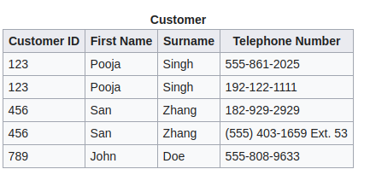
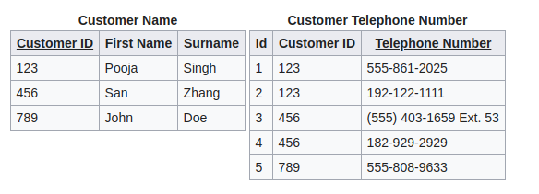
Normal forms
First normal form It should only have single(atomic) valued attributes/columns. Values stored in a column should be of the same domain All the columns in a table should have unique names. And the order in which data is stored, does not matter.

Slide 10
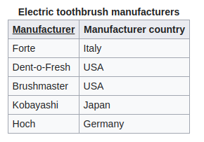
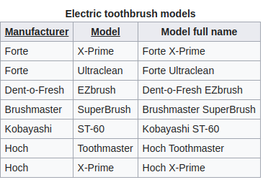
Normal forms
Second normal form It should be in the First Normal form. And, it should not have Partial Dependency.

Slide 11
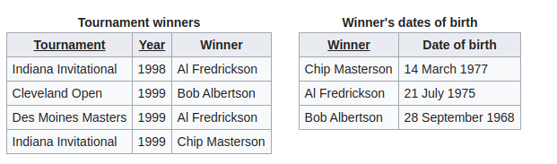
Normal forms
Third normal form It is in the Second Normal form. And, it doesn't have Transitive Dependency.

Slide 12
INSERT , UPDATE
INSERT INTO statement allows one to insert new rows into a table. One can insert a single row at a time or several rows as a result of a query. Specified columns and corresponding values INSERT INTO TABLE_NAME (column1, column2, column3,...columnN) VALUES (value1, value2, value3,...valueN); Only values - it must match all columns with not null property by order INSERT INTO TABLE_NAME VALUES (value1,value2,value3,...valueN);
UPDATE Query is used to modify the existing records in a table. You can use WHERE clause with UPDATE query to update the selected rows. Otherwise, all the rows would be updated. UPDATE table_name SET column1 = value1, column2 = value2...., columnN = valueN WHERE [condition];

Slide 13
DELETE, LIMIT, ORDER, GROUP, LIKE
DELETE Query is used to delete the existing records from a table. You can use WHERE clause with DELETE query to delete the selected rows. DELETE FROM table_name WHERE [condition];
LIMIT clause is used to limit the data amount returned by the SELECT statement. SELECT column1, column2, columnN FROM table_name LIMIT [no of rows]
ORDER BY clause is used to sort the data in ascending or descending order, based on one or more columns. SELECT column-list FROM table_name [ORDER BY column1, column2, .. columnN] [ASC | DESC];
GROUP BY clause is used in collaboration with the SELECT statement to group together those rows in a table that have identical data. SELECT column-list FROM table_name WHERE [ conditions ] GROUP BY column1, column2....columnN
LIKE operator is used to match text values against a pattern using wildcards.

Slide 14
JOINS
A INNER JOIN creates a new result table by combining column values of two tables (table1 and table2) based upon the join-predicate. SELECT table1.column1, table2.column2... FROM table1 INNER JOIN table2 ON table1.common_filed = table2.common_field;
OUTER JOIN is an extension of the INNER JOIN. SQL standard defines three types of OUTER JOINs: LEFT, RIGHT, and FULL and PostgreSQL supports all of these. LEFT For each row in table T1 that does not satisfy the join condition with any row in table T2, a joined row is added with null values in columns of T2. Thus, the joined table always has at least one row for each row in T1. RIGHT For each row in table T2 that does not satisfy the join condition with any row in table T1, a joined row is added with null values in columns of T1. This is the converse of a left join; the result table will always have a row for each row in T2. FULL For each row in table T1 that does not satisfy the join condition with any row in table T2, a joined row is added with null values in columns of T2

Slide 15
Predefined functions SUM, AVG, COUNT
PostgreSQL built-in functions, also called as Aggregate functions, are used for performing processing on string or numeric data. SELECT COUNT(column_name) FROM table_name ; SELECT AVG(column_name) FROM table_name ; SELECT SUM(column_name) FROM table_name ; SELECT MIN(column_name) FROM table_name ; SELECT MAX(column_name) FROM table_name ;

Slide 16

Questions?

